Slide 1
ANZ Virtual Internship Task 1 (Insights from EDA)
Ayooluwa Adedipe
Tools Used: Python Libraries- Pandas, Matplotlib, and Seaborn
Jupyter notebook containing full visualizations is available at this link

Slide 2
Missing Data
Five of the columns with missing data were associated with card issuance and merchant details, meaning it is the Missing At Random variant of missing data. The affected rows can either be deleted.
The other two columns with missing data have about 90% data missing, these columns should be dropped

Slide 3
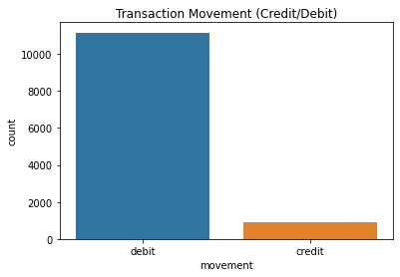
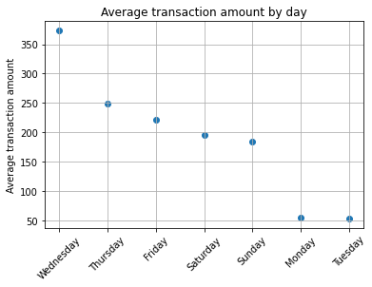
Segmentation by time and transaction Volume
Most transactions are debit transactions. Only 7.33% of total transactions were credit transactions (retention strategies needed)
The average transaction is about AUD190 (AUD187.93) while an average of about 4,000 transactions (4014.33)are carried out monthly.
On average, Wednesdays record the highest transaction amounts while Monday and Tuesday have the lowest

Slide 4
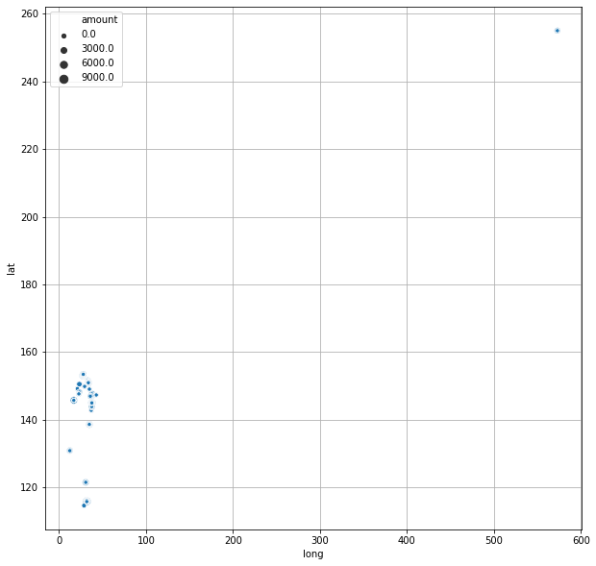
Geographical distribution
Most transactions occurred close to each other except an outlier that occurred far from the others as shown in the visualization to the right

